Slide 1
Machine Learning Fairness Algorithms
Chulin Tang, Rui Chen and Aojie Li

Slide 2
Introduction
Handling Conditional Discrimination
COMPAS dataset
Notes:
The problem of Handling Conditional Discrimination in machine learning and decision-making systems refers to the challenge of ensuring that algorithms do not perpetuate or exacerbate discrimination based on sensitive attributes, such as race, gender, or age, especially when such discrimination is contingent upon other variables or occurs in particular subgroups.
This presentation delves into the COMPAS dataset to explore racial disparities in recidivism rates. The goal is to identify a model to predict the rate of

Slide 3
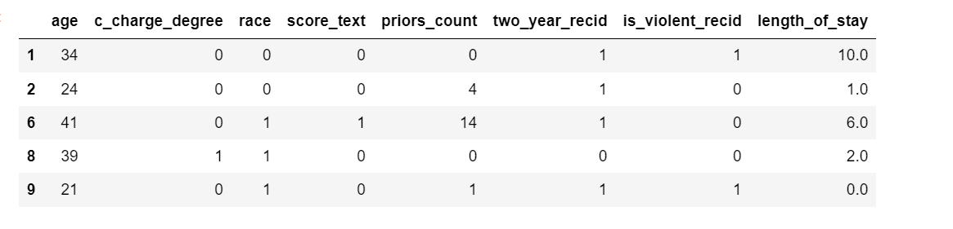
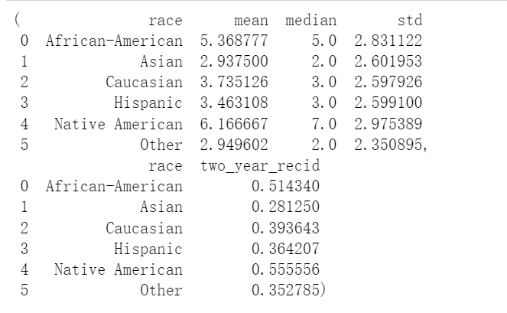
Data Overview

Slide 4
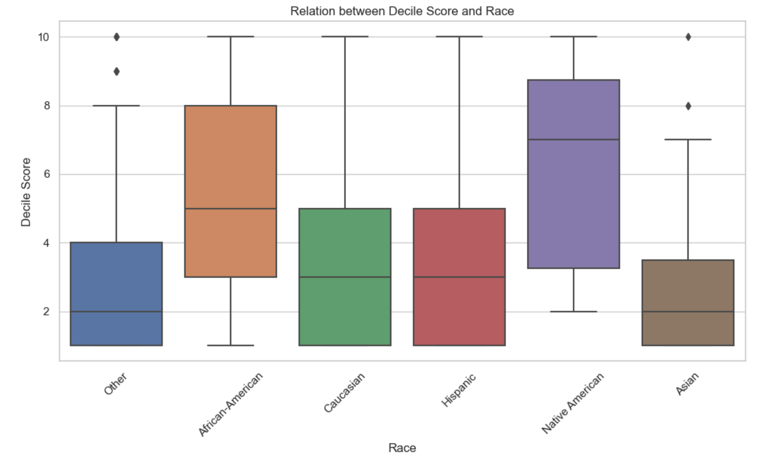
Statistical Analysis
Notes:
We use summary statistics and box plots of decile scores across races to find property of this dataset. These analyses highlight the underlying differences and potential biases in the data.

Slide 5

Model Overview
Logistic Regression with Prejudice Regularizer
Handling Conditional Discrimination
Notes:
Logistic Regression with Prejudice Regularizer is a variant of logistic regression. Logistic regression models the probability that a given input belongs to a certain category. The "Prejudice Regularizer" is an additional term in the logistic regression loss function that penalizes the model for making decisions based on sensitive attributes that could lead to biased outcomes. The idea is to reduce prejudice or discrimination against certain groups by diminishing the influence of features that correlate closely with sensitive attributes like race, gender, or age.
Handling Conditional Discrimination is a method ensure that predictive models treat individuals equitably across different subgroups, particularly when conditional factors are involved. Conditional factors can include any variable that interacts with sensitive attributes (like race or gender) in a way that might influence the outcome of a model's prediction.

Slide 6
Model Training and Evaluation
Training Set
Testing Set
Validation Set
Notes:
We split the data set into three parts
Training Set: This is the largest portion of the dataset and is used to train the machine learning model. The model learns to make predictions or classify data based on this set. It's like the textbook for the model from which it learns patterns and correlations.
Testing Set: After the model has been trained, the testing set is used to evaluate its performance. This data is never seen by the model during the training phase. It provides an unbiased evaluation of a final model fit on the training dataset.
Validation Set: This is a separate portion of the dataset that is used to fine-tune the model parameters and to provide an unbiased evaluation of a model fit during the training phase. It's used to protect against overfitting and to ensure that the model's performance generalizes well to new, unseen data.
Using these three distinct sets allows developers and data scientists to train robust models while maintaining a good balance between bias and variance, aiming for a model that generalizes well rather than memorizing the training data or failing to capture the underlying trend.

Slide 7
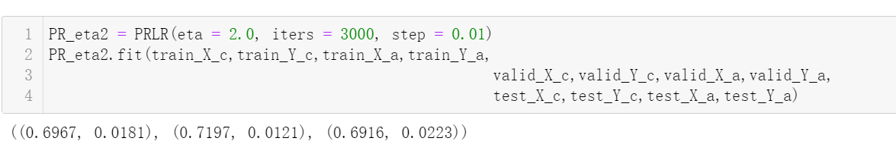
Model Training and Evaluation
Notes:
After split the data set, we do regression, and get the result accuracy for Logistic Regression with Prejudice Regularizer
The accuracy scores on the training, validation, and test sets are close. This suggests that the model generalizes well and is not overfitting the training data.
The fairness metric or loss (assuming the second value in each pair represents this) is low, indicating that the model's predictions are relatively fair between the two groups, according to the custom fairness constraint embedded in the PRLR model.
The model's performance in terms of fairness is better on the validation set compared to the training and testing sets, as indicated by the lower fairness metric (0.0121 on validation vs. 0.0181 on training and 0.0223 on testing). This is need to investigate further, as one would ideally want the fairness metric to be consistent across all sets.

Slide 8
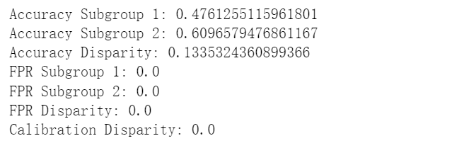
Result for Handling Conditional Discrimination
Notes:
For the Handling Conditional Discrimination method Here's a noticeable difference in accuracy between the two subgroups, suggesting the model performs better for one group over the other, which could indicate bias. Also, the result shows signs of bias in accuracy but performs consistently across groups in terms of calibration. The zero FPR for both groups needs further investigation.

